Slide 1



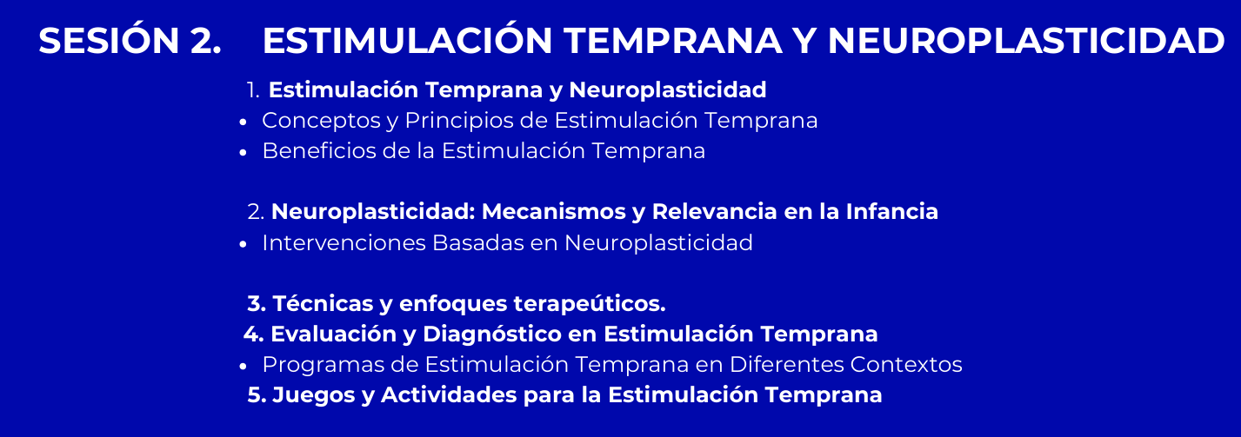
Jose Manuel Herrera Barrera
Fisioterapeuta de la Universidad de La Sabana
Mg. Educación Médica Universidad de La Sabana
Candidato doctoral
24 de Agosto del 2025

Slide 2
Evaluar y aplicar técnicas de estimulación temprana basadas en la neuroplasticidad para la intervención en el desarrollo motor de niños, utilizando escalas de evaluación como la Escala Alberta y el General Movement Assessment, y promover la adaptación de estas técnicas en distintos contextos clínicos.

Slide 3

¿Qué anécdota les gustaría contar sobre neuroplasticidad?
Credenciales de contenido. Generado con IA ∙ Enero de 2025. Bing Image Creator

Slide 4
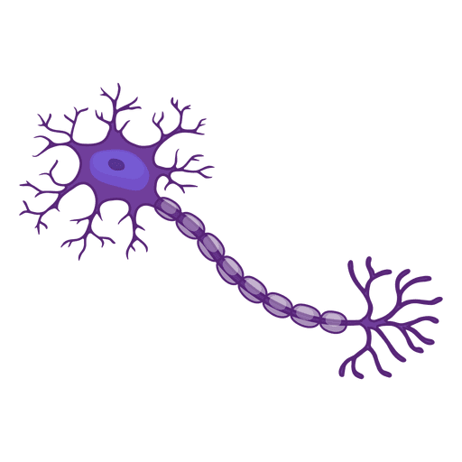
- Neurogénesis
- Colateralización
- Regeneración axonal
- Eficacia sináptica
- Neuroquímicos
- Dabrowski J, Czajka A, Zielinska-Turek J, et al. Brain functional reserve in the context of neuroplasticity after stroke. Hindawi. 2019.
- Gómez Soriano J, Taylor J. Neuroplasticidad. En: Cano de la Cuerda R, Collado Vázquez S. Neurorrehabilitación métodos específicos de valoración y tratamiento. 1ª Ed. Madrid: Panamericana; 2012. p. 89-98.

Slide 5

- Teoría de la evolución
“Survival of the fittest”
Adaptación al entorno
Credenciales de contenido. Generado con IA ∙ Enero de 2025. Bing Image Creator

Slide 6
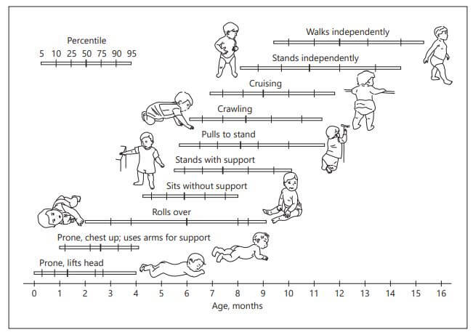
1. Prematuridad
2. Parálisis cerebral infantil (PCI)
3. Retraso global del desarrollo
4. Trastornos del espectro autista (TEA)
5. Síndromes genéticos
6. Déficit sensorial
7. Trastornos neuromusculares
8. Cardiopatías congénitas
9. Crisis convulsivas neonatales o epilepsia infantil
10. Desnutrición y malnutrición crónica
11. Trastornos de apego o negligencia temprana
12. Hiperbilirrubinemia severa
13. Malformaciones congénitas
Tomado de elfisiopediatric, 2023. Disponible en: https://efisiopediatric.com/por-que-la-adquisicion-de-las-habilidades-motoras-es-esencial-dentro-del-desarrollo-conductual-de-los-ninos/

Slide 7
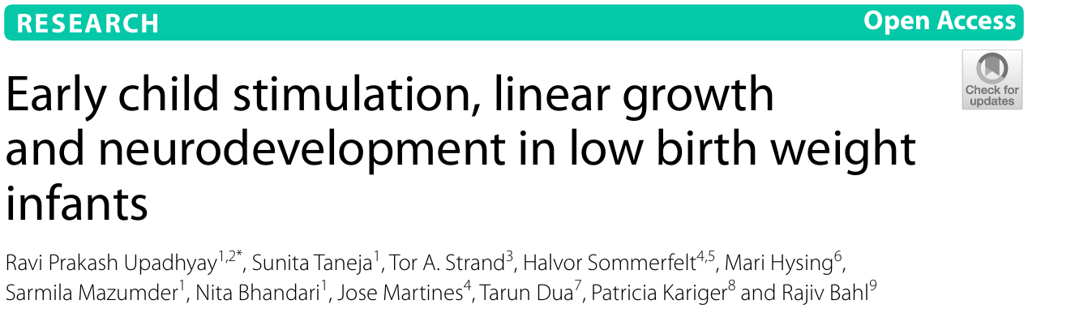
“-Early child stimulation may particularly be beneficial for LBW infants with linear growth deficits/stunting.
-Moderate to high-quality stimulation at home may alleviate the risk of poor development scores in LBW infants with linear growth deficits.
-Efforts for improving child development should be comprehensive with promotion of adequate nutrition and optimal nurturing care as integral components.”
“Linear growth faltering in the first 2 years of life has been shown to be negatively associated with cognitive performance in childhood.”
Upadhyay, R. P., Taneja, S., Strand, T. A., Sommerfelt, H., Hysing, M., Mazumder, S., Bhandari, N., Martines, J., Dua, T., Kariger, P., & Bahl, R. (2022). Early child stimulation, linear growth and neurodevelopment in low birth weight infants. BMC Pediatrics, 22(1). https://doi.org/10.1186/s12887-022-03579-6

Slide 8
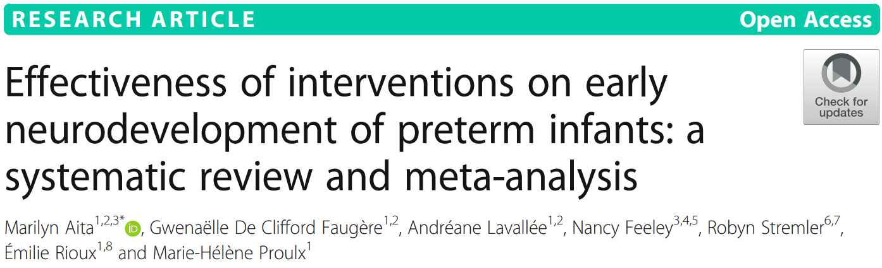
“Future studies are needed to identify the interventions that are the most effective in promoting preterm infants’ neurodevelopment during NICU hospitalization or close to term age. Without a clear definition of neurodevelopment, interventions should be appropriately designed to allow comparison with previous studies and instruments should be combined to measure different aspects of infants’ neurodevelopment”
“Preterm infants are more likely to have significant short -and long- term neurodevelopmental impairments, since their brains go through a critical period of development and maturation between 24 and 40 weeks of gestation occurring mainly during their NICU hospitalization”
Aita, M., de Clifford Faugère, G., Lavallée, A., Feeley, N., Stremler, R., Rioux, É., & Proulx, M. H. (2021). Effectiveness of interventions on early neurodevelopment of preterm infants: a systematic review and meta-analysis. BMC Pediatrics, 21(1). https://doi.org/10.1186/s12887-021-02559-6

Slide 9
Compared to standard care or other type of comparators
“Overall, multisensory stimulation interventions were found to improve neuromuscular development [39] and neurological development [33].In addition, music was reported to improve neuromotor and neurological development [38]. Conversely, a tactil estimulation intervention along with physical activity and/or hydrotherapy was not found to improve neurobehavioral [36] or neuromotor and neuromuscular development [37]."
Aita, M., de Clifford Faugère, G., Lavallée, A., Feeley, N., Stremler, R., Rioux, É., & Proulx, M. H. (2021). Effectiveness of interventions on early neurodevelopment of preterm infants: a systematic review and meta-analysis. BMC Pediatrics, 21(1). https://doi.org/10.1186/s12887-021-02559-6

Slide 10
Assessment of Preterm Infant Behavior (APIB)
NICU Neonatal Neurobehavioral Scale (NNNS)
Neonatal Neurobehavioral Examination (NNE)
Neuromotor development Infant Neurological International Battery (INFANIB)
Test of Infant Motor Performance (TIMP)
Neuromuscular development (New Ballard Score and Dubowitz examination)
Neurological development (Prechtl Neurological Examination of the Full-term Newborn)
Test de Denver II
Escala de Apgar
Peabody Developmental Motor Scales (PDMS-2)
Alberta Infant Motor Scale (AIMS) Colombia
Movement Assessment Battery for Children (MABC-2)
Hammersmith Infant Neurological Examination (HINE) 2 a 24 meses
General Movements Assessment (GMA) <2 meses “Fidgety movements”
Test of Infant Motor Performance (TIMP)
Pediatric Evaluation of Disability Inventory (PEDI)
Gross Motor Function Measure (GMFM)
Infant Sensory Profile 2

Slide 11
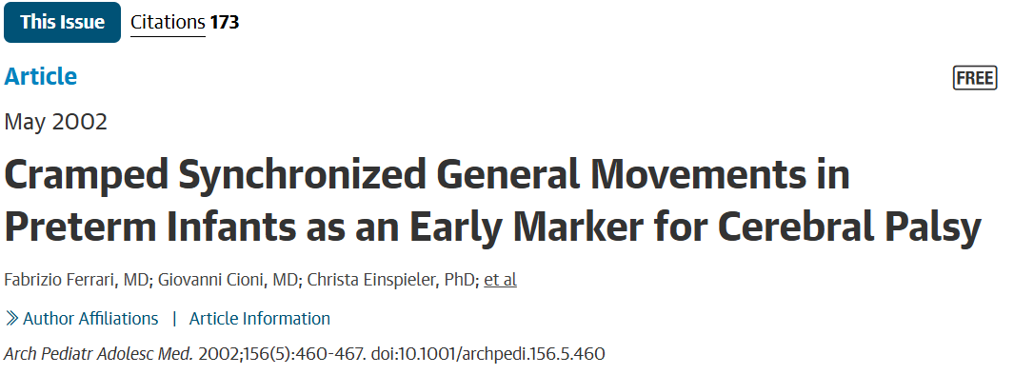
https://jamanetwork.com/journals/jamapediatrics/fullarticle/191860?utm_campaign=video&utm_medium=social&utm_source=youtube&utm_content=public

Slide 12
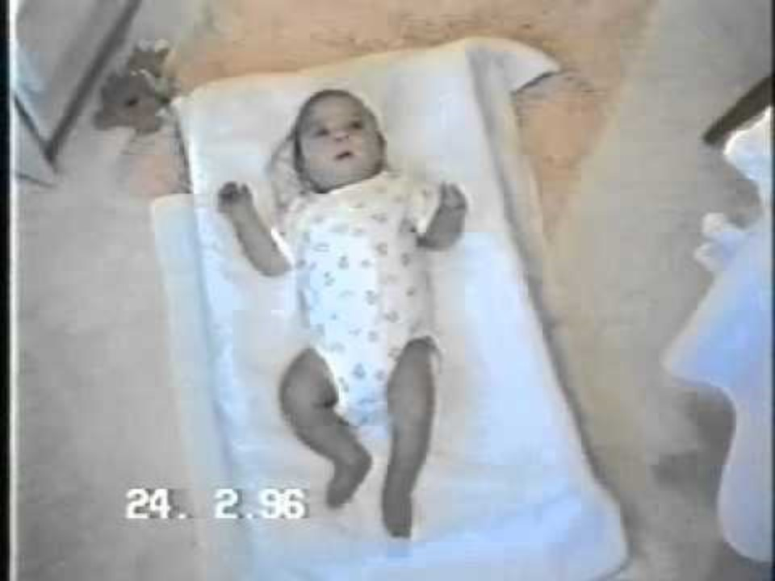
Normal Fidgety Movements
https://www.youtube.com/watch?v=2tGAK8BKJwo

Slide 13
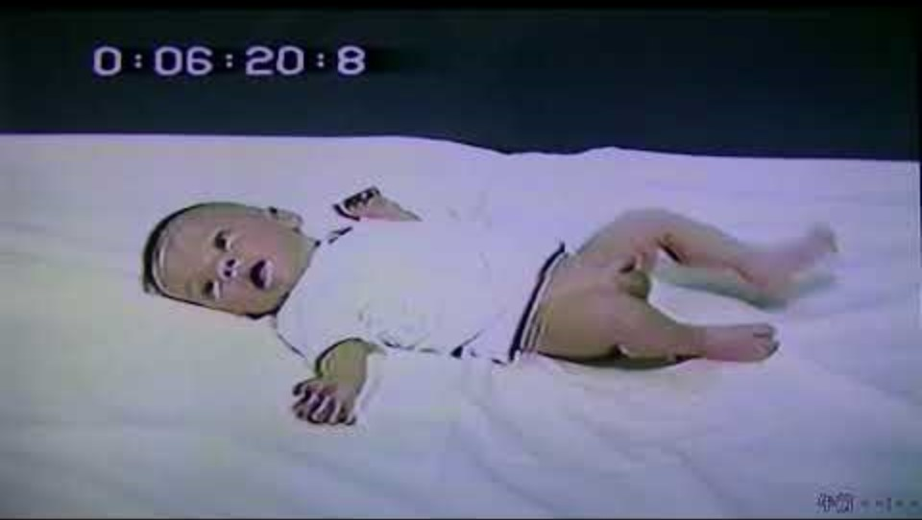
¿Ven algún movimiento general diferente?
Abnormal Fidgety Movements
https://www.youtube.com/watch?v=F8qMfd5Kjzc

Slide 14
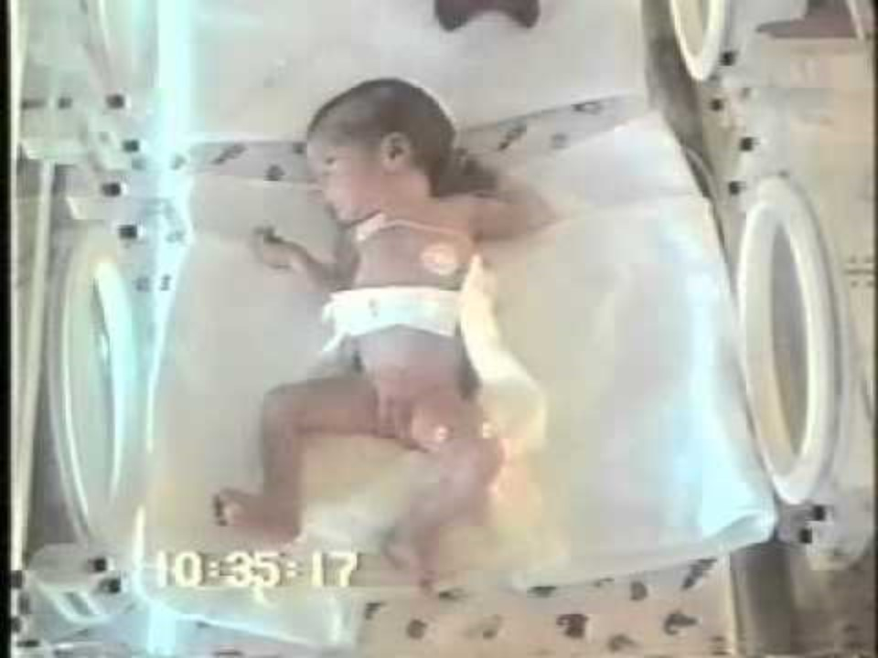
Abnormal Fidgety Movements
https://www.youtube.com/watch?v=2tGAK8BKJwo

Slide 15
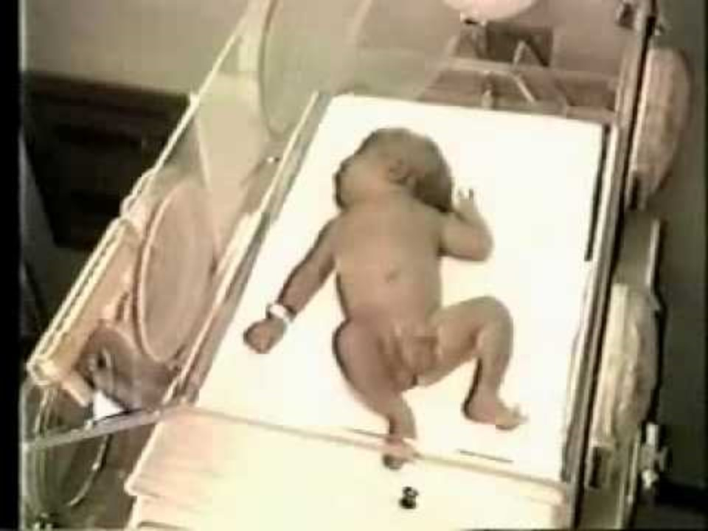
Cramped Synchronized Movements
https://www.youtube.com/watch?v=LSa4jENxgLk

Slide 16
Descanso 20 min

Slide 17
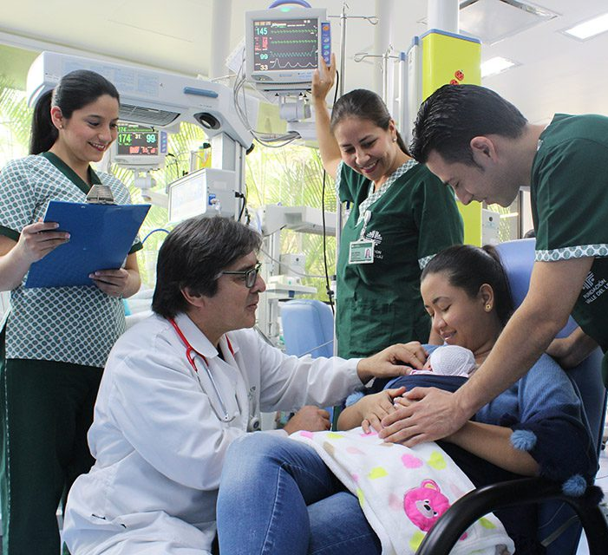
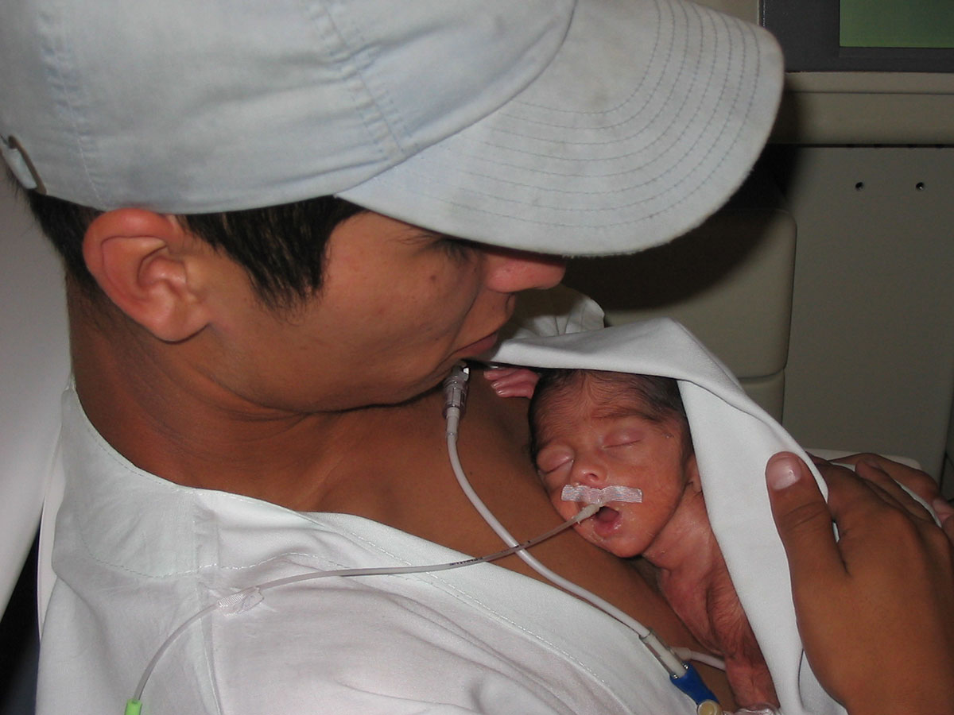
Cuidados Intensivos e Intermedios Neonatales. Fundación Valle de Lili. Disponible en https://valledellili.org/departamentos-y-servicios/cuidados-intensivos-e-intermedios-neonatales/
Madre canguro. Fundación canguro. III Encuentro Nacional del Método Madre Canguro. Disponible en: https://fundacioncanguro.co/iii-encuentro-nacional-en-metodo-madre-canguro/

Slide 18
Concepto Bobath
- Convicción del terapeuta
- Autorregular al bebé
- Individualizada
- Fortalezas del individuo
- Padres acompañando
- Transición activa
- Puntos de control
De lo masivo a lo selectivo
De lo proximal a lo distal
De lo cefálico a lo caudal
Bojta
Bobath Concept: Theory and Clinical Practice in Neurological Rehabilitation. (n.d.).

Slide 19
Concepto Bobath
Etapas del control motor
Movilidad
Postura
Movilidad controlada
Destreza/Locomoción
Tomado de elfisiopediatric, 2023. Disponible en: https://efisiopediatric.com/por-que-la-adquisicion-de-las-habilidades-motoras-es-esencial-dentro-del-desarrollo-conductual-de-los-ninos/

Slide 20
Concepto Bobath
5 minutos de descanso
Tomado de elfisiopediatric, 2023. Disponible en: https://efisiopediatric.com/por-que-la-adquisicion-de-las-habilidades-motoras-es-esencial-dentro-del-desarrollo-conductual-de-los-ninos/

Slide 21
Quiz
Tomado de elfisiopediatric, 2023. Disponible en: https://efisiopediatric.com/por-que-la-adquisicion-de-las-habilidades-motoras-es-esencial-dentro-del-desarrollo-conductual-de-los-ninos/

Slide 22
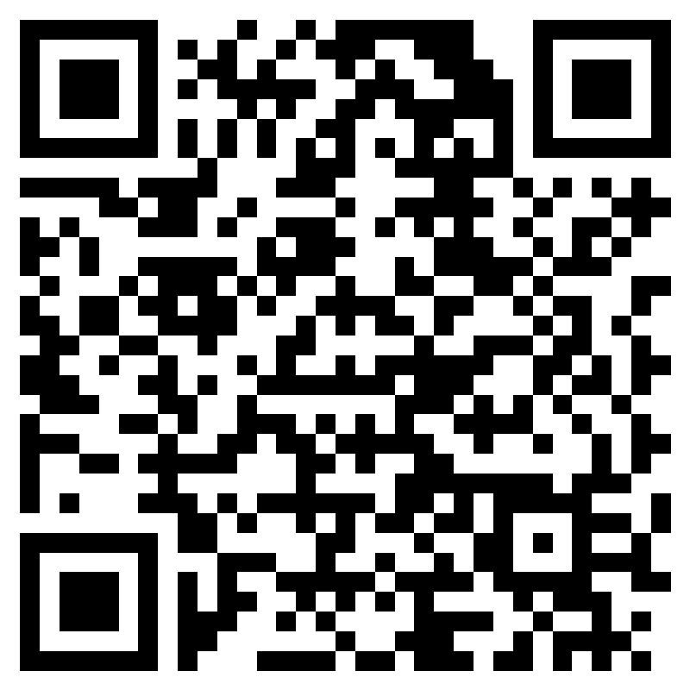
Tomado de elfisiopediatric, 2023. Disponible en: https://efisiopediatric.com/por-que-la-adquisicion-de-las-habilidades-motoras-es-esencial-dentro-del-desarrollo-conductual-de-los-ninos/

